Slide 1
WELCOME TO PROJECT
PEACEFINDER

Slide 2

Today we did our first project in part of Hackathon conducted @KIET GROUP OF INSTITUTIONS
In this project we used webpage developing languages like HTML and CSS.
So lets know in detail of HTML, CSS and as well as our project.

Slide 3
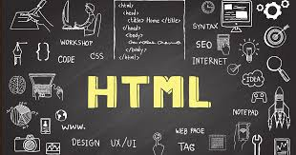
What is HTML?
The HyperText Markup Language or HTML is the standard markup language for documents designed to be displayed in a web browser. It defines the meaning and structure of web content. It is often assisted by technologies such as Cascading Style Sheets and scripting languages such as JavaScript.
HTML is the backbone of website design and function. It provides a structure for web pages that allows browsers to understand and display the content on the page. By understanding how HTML works, you can create better websites with more sophisticated features.

Slide 4
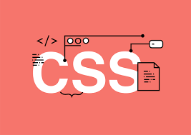
What is CSS?
Cascading Style Sheets is a style sheet language used for describing the presentation of a document written in a markup language such as HTML or XML. CSS is a cornerstone technology of the World Wide Web, alongside HTML and JavaScript.
There are three types of CSS which are given below:
Inline CSS.
Internal or Embedded CSS.
External CSS.

Slide 5
Our Web page title is PEACEFINDER
In this website we updated about what are the peaceful places we travelled till now.
We added 4 places in it. They are
Taj Mahal
Munnar
Kashmir
Vrindavan

Slide 6
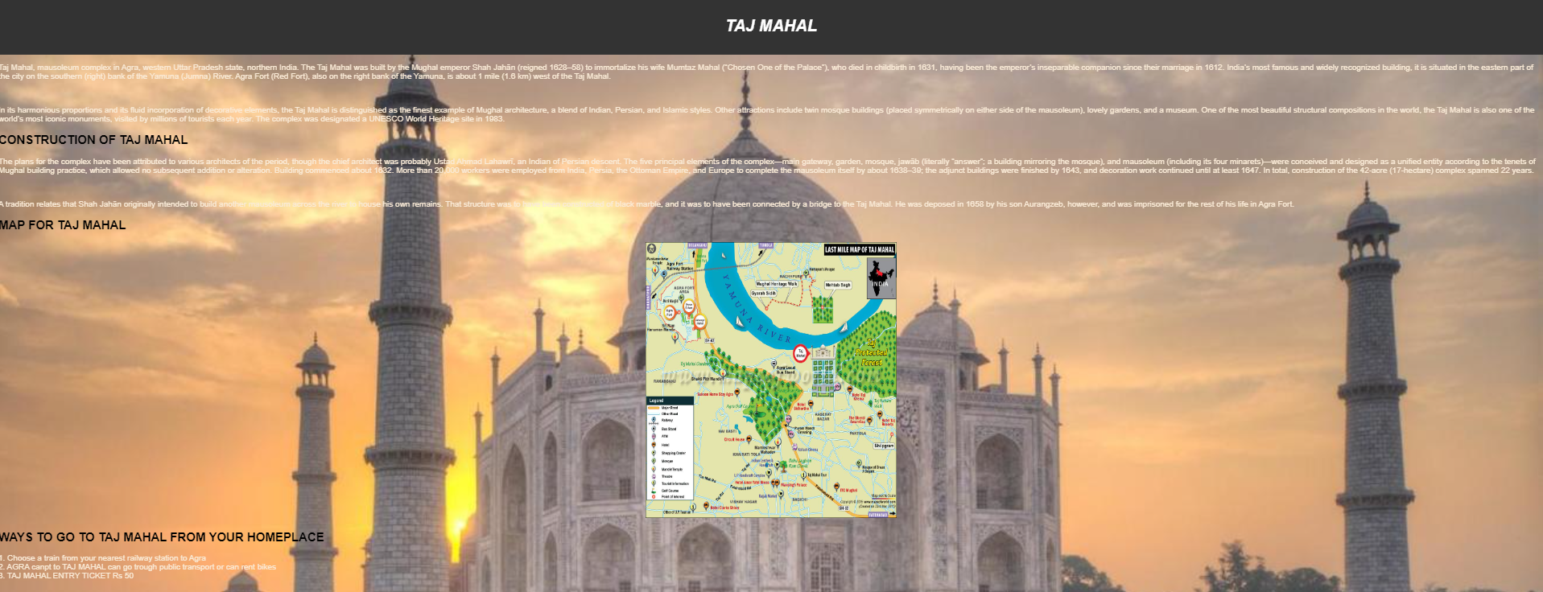
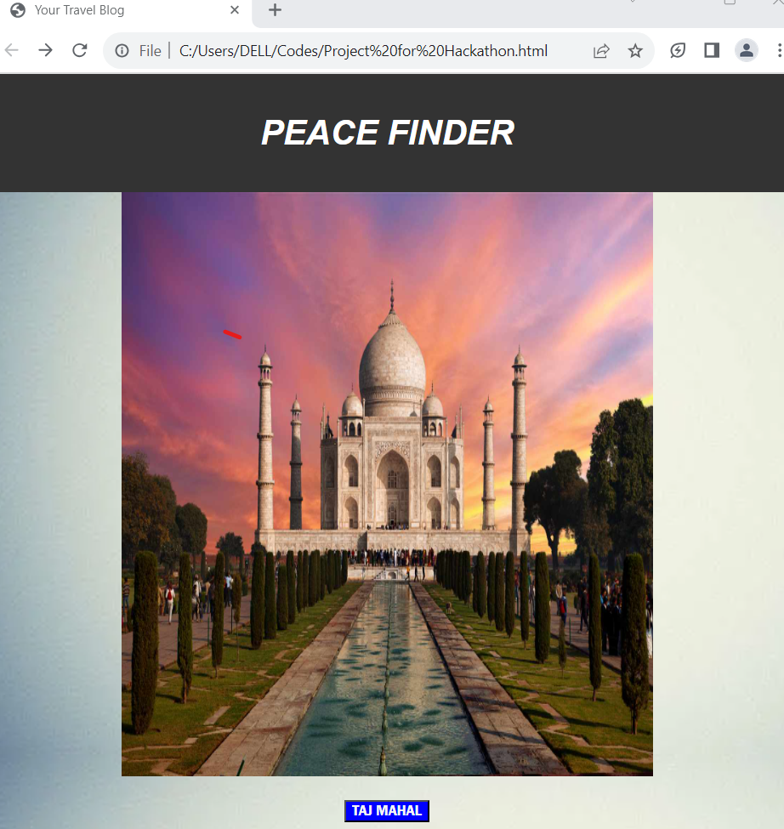
TAJ MAHAL

Slide 7
About Taj Mahal
Construction
map
Transportation

Slide 8
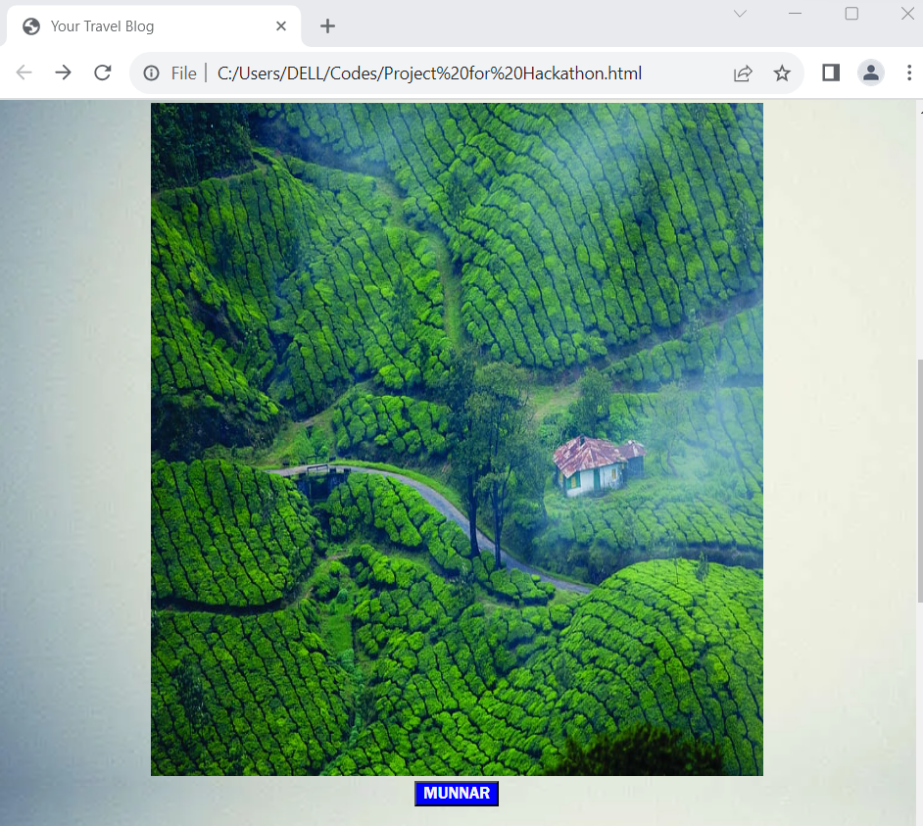
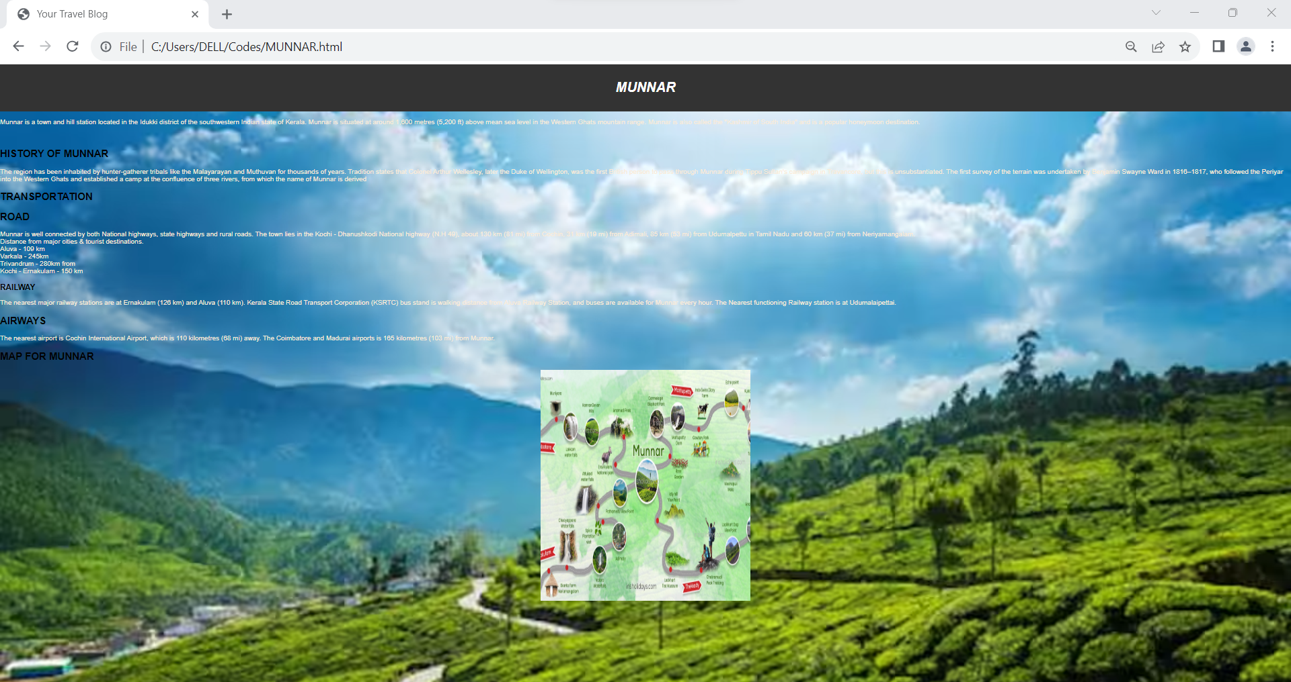
MUNNAR

Slide 9
About Munnar
History of Munnar
Transportation to Munnar
Map of Munnar

Slide 10
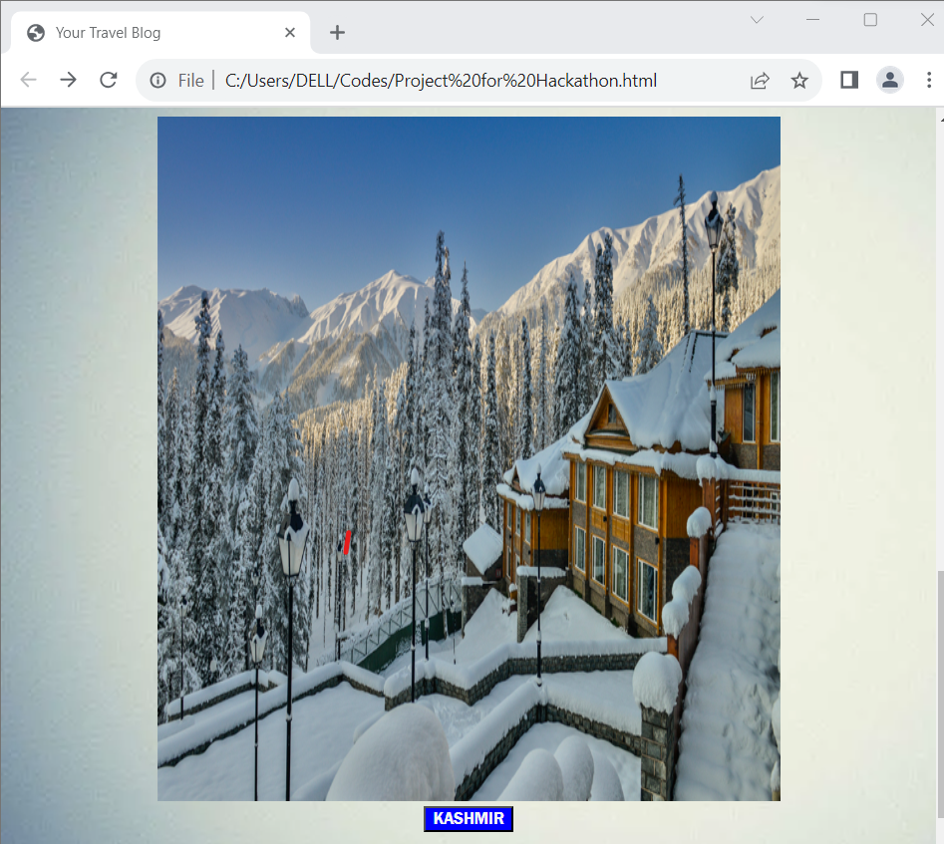
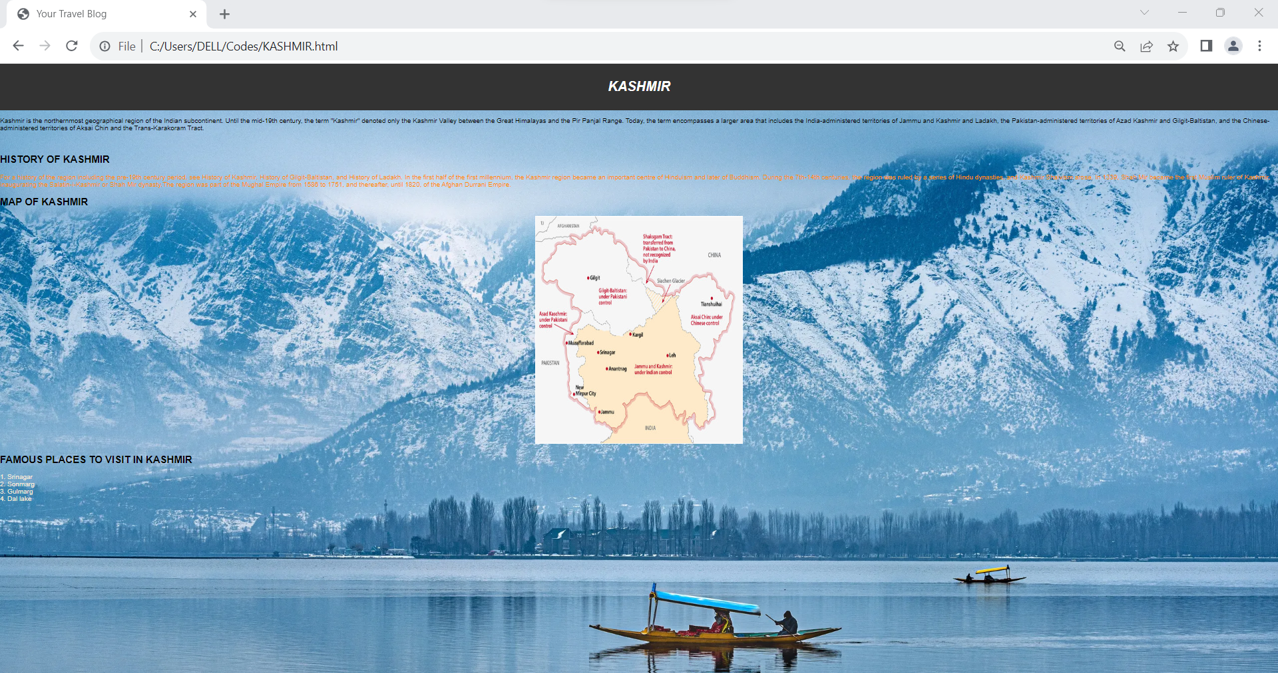
KASHMIR

Slide 11
About Kashmir
History of Kashmir
Map of Kashmir
Famous Places in Kashmir

Slide 12
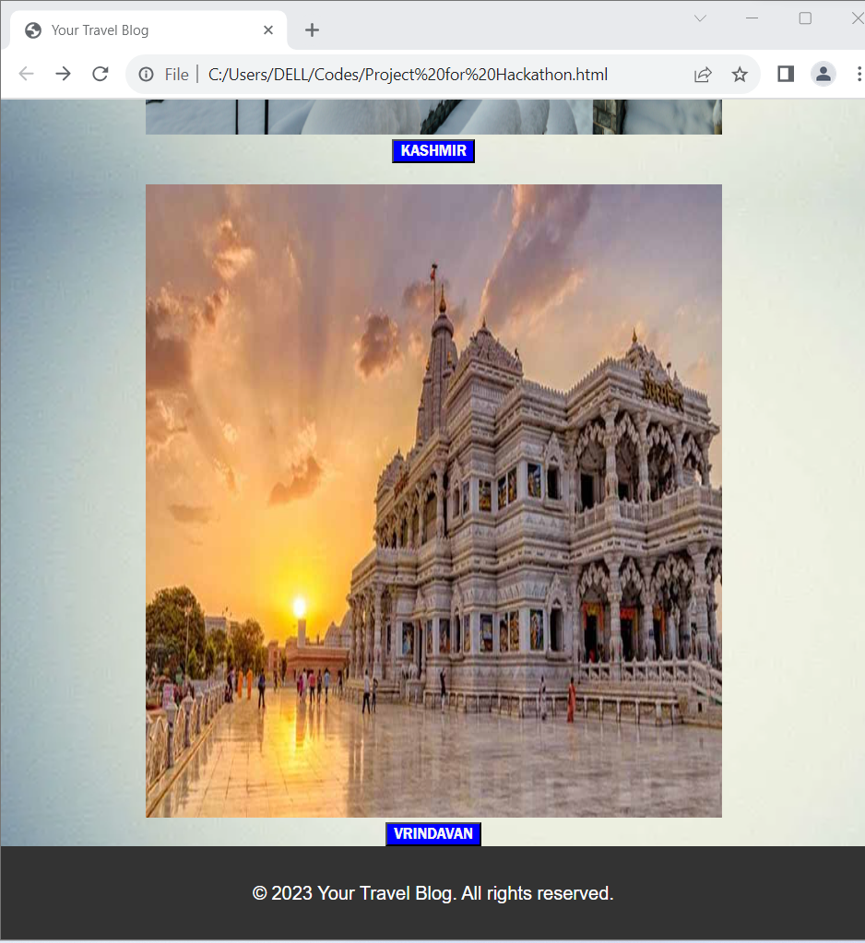
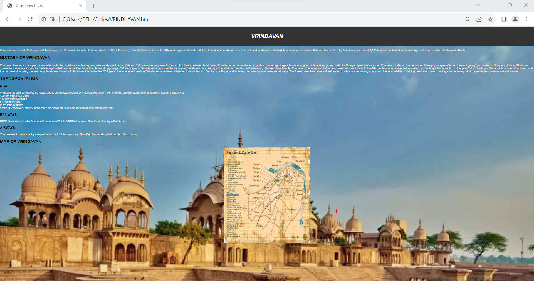
VRINDAVAN

Slide 13
About Vrindavan
History of Vrindavan
Transportation to Vrindavan
Map of Vrindavan

Slide 14
OUR PROJECT is done using these Elements
Thank You for sparing your valuable time to see our project
- P. Praveen Kumar Reddy
- V. Ramakrishna
- K. Surya Praveen
- G. Satyanarayana

